Slide 1




Slide 2

Team
High Concept
Vision ‚Reminder‘
USPs
Target Group
Difficulty Core
7. Art Style
8. Features – Done
9. Open Features
10. Goals – Milestone 01
11. Goals – Milestone 02
13. The Task Plan of the Team
14. Tools

Slide 3

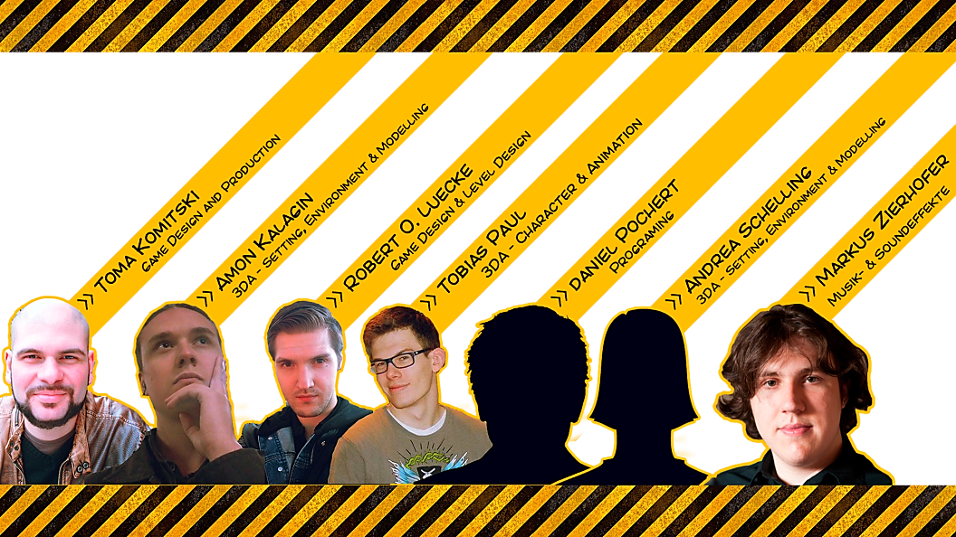

Slide 4
:: High Concept
Labyrinth
Top-Down-Orthographie
Zombie-Apokalypse
Rollstuhl mit kaputten Bremsen
Survival-Run
Pacman+
Special Items
Kriegsveteran
Hectic and dynamic gameplay
Missions

Slide 5
:: Vision Reminder
* inspired by the old school arcade legend “Pac-man”
Desired Outcome hectic and dynamic gameplay into a modern comic-theme with more complex mechanics
Main Goal of S.A.W.Z.E
* collectable power up items
** different opponent types
*** added level objectives to achieve and challenge
**** remain simple, intuitive and dynamic gameplay

Slide 6
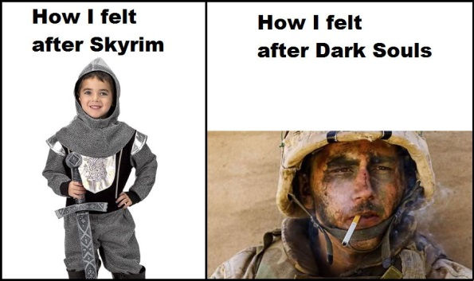

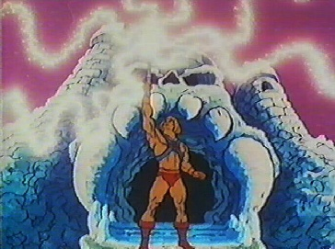
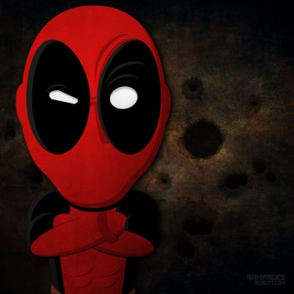
:: USPs
* Level Objectives * Dynamic Gameplay * Power ups * Comic Style with Irony

Slide 7

:: Target Group
Age restriction
6+
Gender
Both
Gaming experience
none required
Platform
PC exclusive
Genre
Combination of “arcade” and “jump and run”

Slide 8
:: Difficulty Core
* scale of the level + minimap *quantity of Zombie Opponents *areas infected by Z-Virus
*quality of Zombie opponents *amount of collectable objective items
*amount of antidotes placed on the level
*Box shift

Slide 9
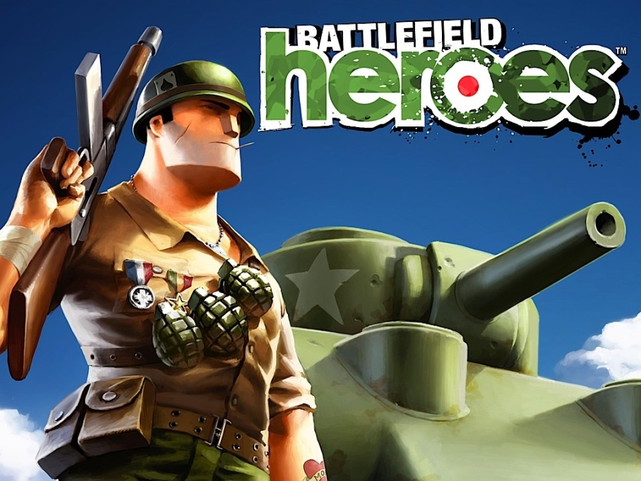
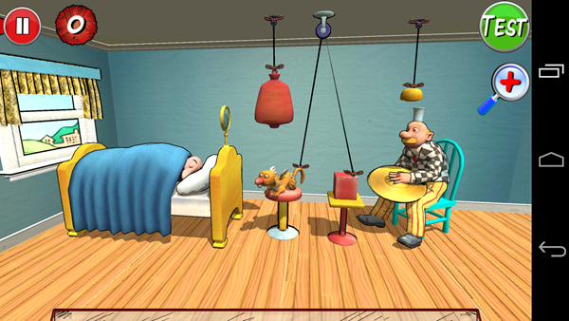
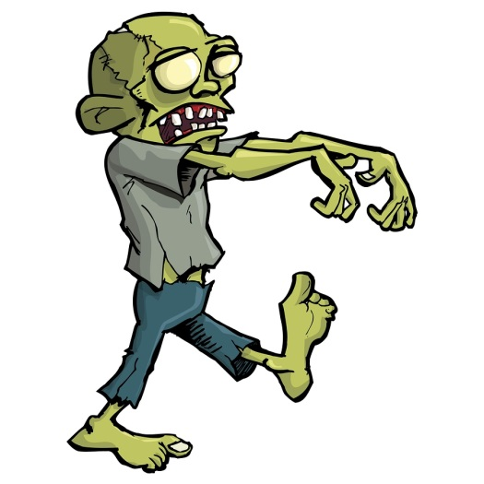
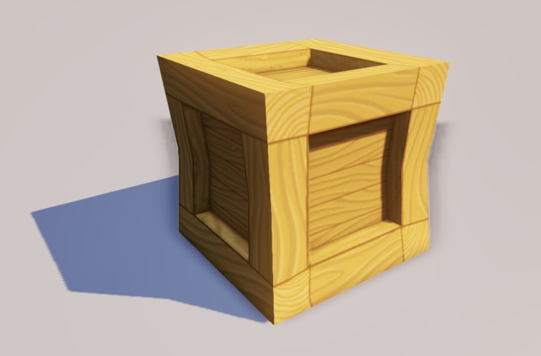
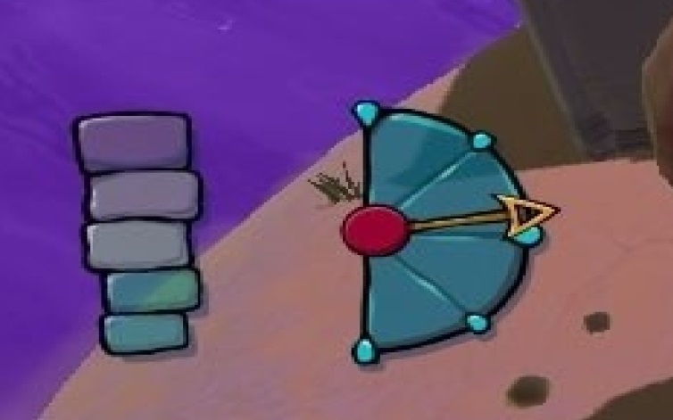
:: Art Style

Slide 10
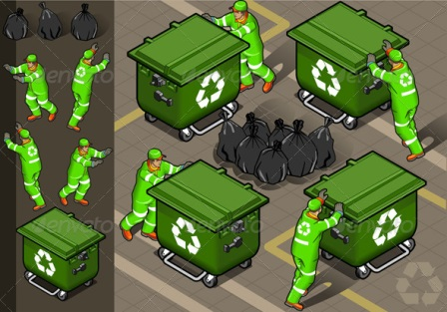
:: Art Style

Slide 11
:: Selfmade!

Slide 12
:: Features Done
* Game Objective 1 – collect Item
*Game objective 2 – save trapped Survivor
*Power up – Nitro Pack
*Zombie Type 1
*Z-Virus Cloud
*Antidote Collectables

Slide 13
:: Goals - Milestone 01 - Comparison
* Hero – 80% * 2 Spielmodi * 1 Zombie – Trapped survivor * 5 level Obstacles – more than 35 Assets in 2 settings ☺ (not implemented yet) * Menu works - design in progress * 2 Power Ups * 5 Levels incl. 3 Tutorials (Tutorial in one level)

Slide 14
:: Goals - Milestone 02 – Aims & Goodwill
* GUI polish
* Sound and Soundtrack * Level + 4
* Zombie type +1
* Trapped survivor +1
* 2 Settings with distinctive flavour
* Power ups + 2

